Slide 1

Isaura Cabrera
Tony Zhao

Slide 2

IMAP
For this project we will be implementing IMAP. IMAP allows its users to access their email regardless of what device they may be using. This also allows the user, to view their messages without having to save them onto their device. We can freely delete, respond & select certain emails.

Slide 3

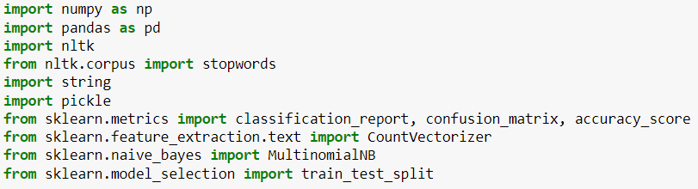
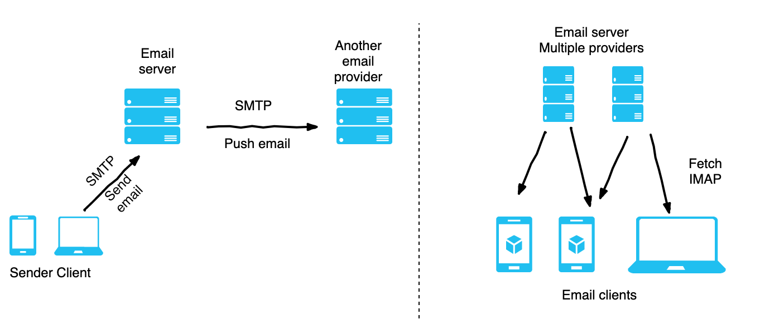


Libraries
In order to begin working with our model and successfully classify the emails. We will be using the libraries listed below:

Slide 4
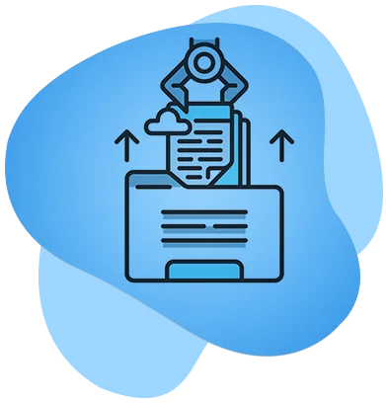
Data Extraction
All emails in our Dummy Email will be extracted onto jupyter notebook. This is also including Spam in order to train our model appropriately for future classification .

Slide 5
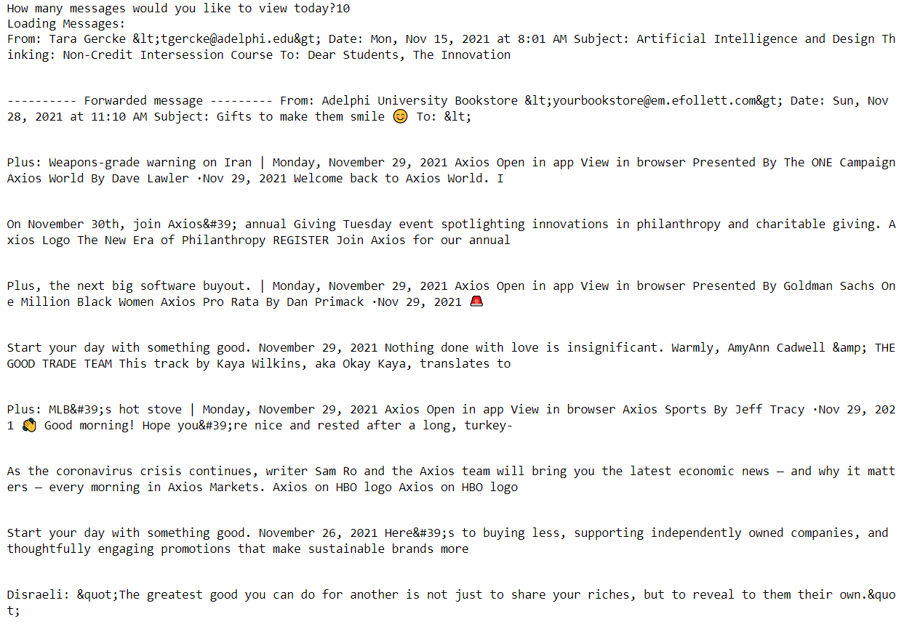
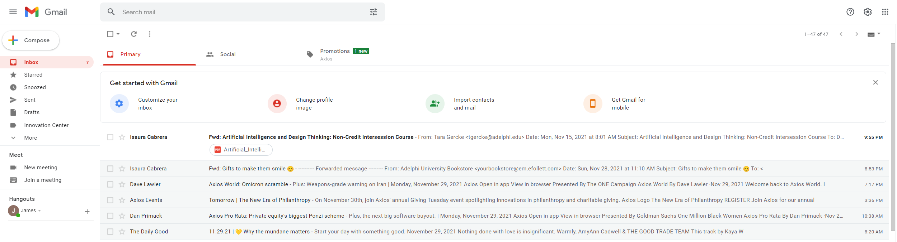
Data Processing
Below are one of the first initial steps that we have taken for data processing:
After implementing appropriate libraries, We are now able to view emails in our Jupyter Notebook:
Viewing emails in our dummy account.
(The Dummy Email was subscribed to websites for realistic spam)

Slide 6
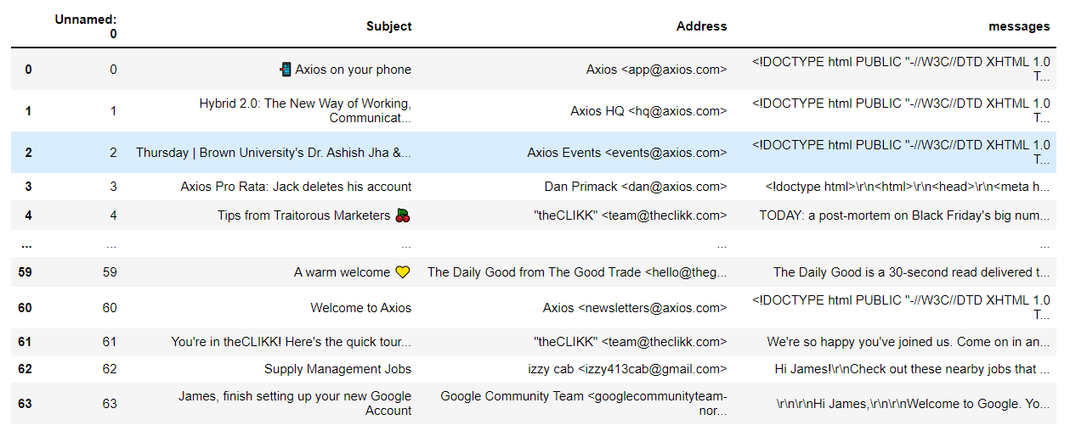
Data Frame
After loading the emails onto jupyter notebook, we created a data frame to begin working with our model. This is including the Subject of the email, The Senders email address and lastly the body of the email. For JARVIS to complete tasks, we will focus solely on the Subject line & Body for email classification.

Slide 7
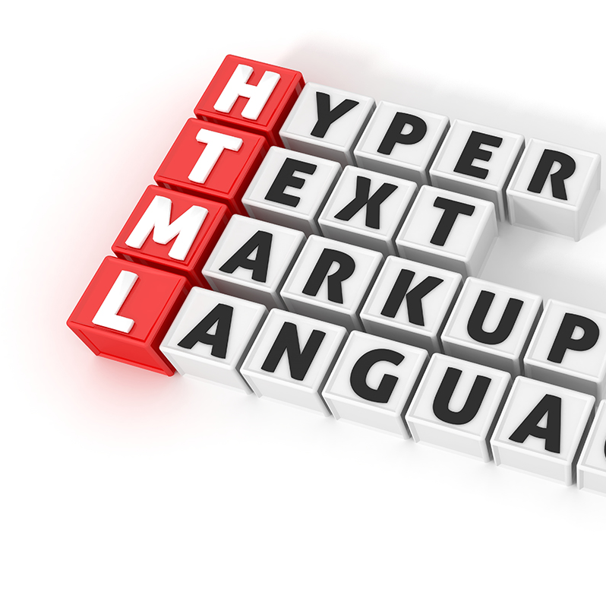
Conclusion
Our focus for our next presentation will be decoding HTML messages. After successfully decoding HTML messages, we can begin our data transformation. This includes cleaning, filtering and organizing the data that is in our data frame.
Cites used:
“Microsoft.” Microsoft Support, https://support.microsoft.com/en-us/office/what-are-imap-and-pop-ca2c5799-49f9-4079-aefe-ddca85d5b1c9.
“IMAPLIB - IMAP4 Protocol Client¶.” Imaplib - IMAP4 Protocol Client - Python 3.10.0 Documentation, https://docs.python.org/3/library/imaplib.html#imaplib.IMAP4_SSL.
“Easyimap.” PyPI, https://pypi.org/project/easyimap/.

